Slide 1
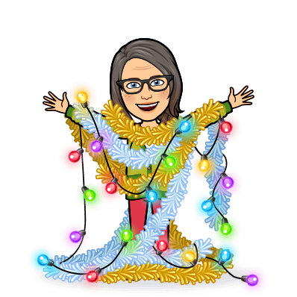
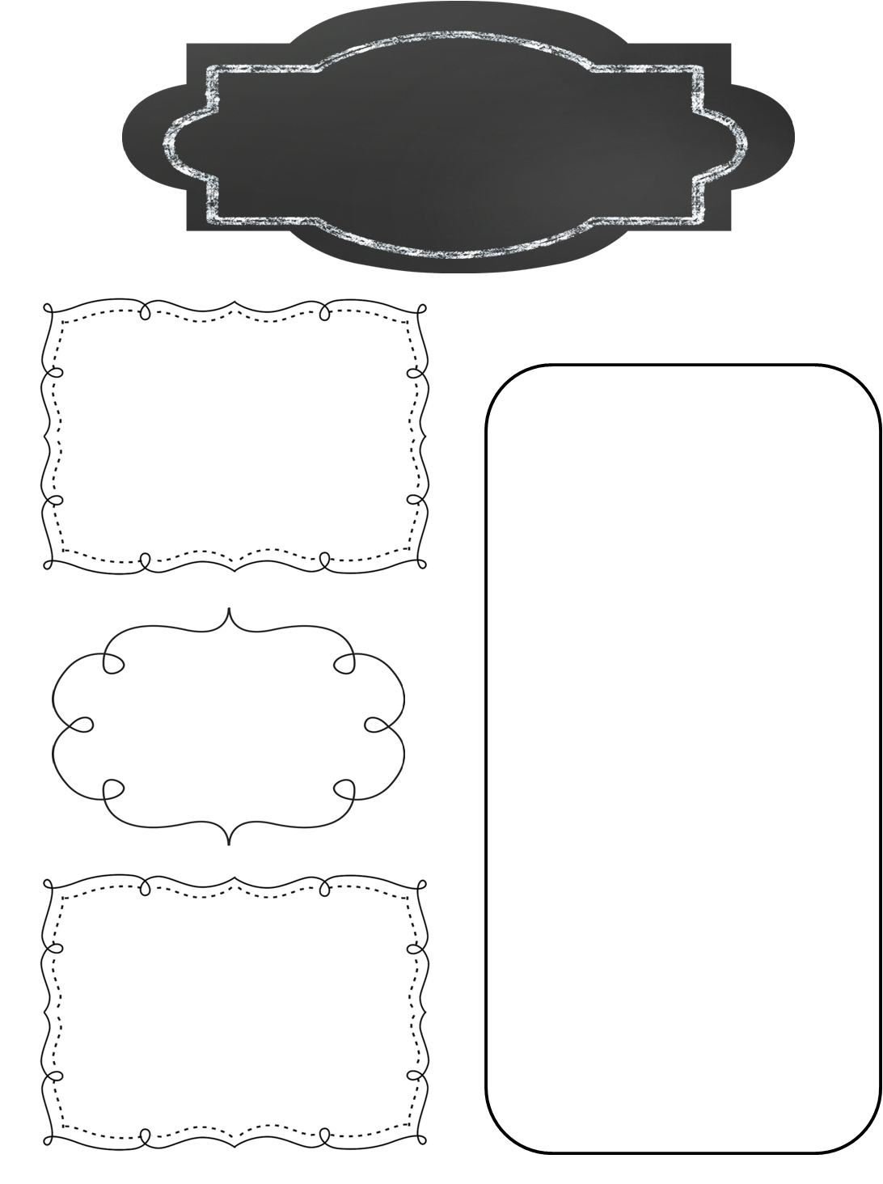
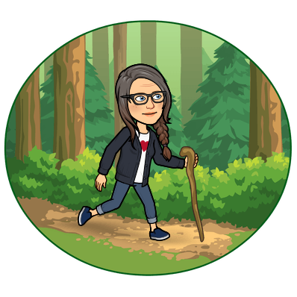
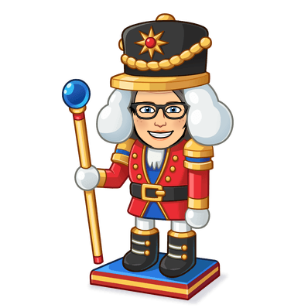
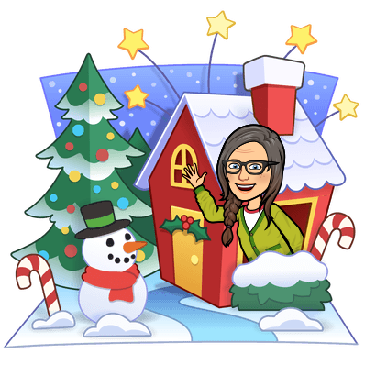
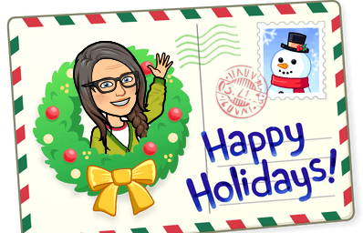
A Peek at Next Week in…
Mrs. Miller’s Class
December 16-20, 2024
What We’re Reading!
Weekly Focus
The Carpenter’s Gift
How the Grinch Stole Christmas
Night Tree
The Berenstain Bears Christmas Tree
Santa’s New Suit
Math
Chapter 8:
Add and Subtract with
Multi-Digit Numbers/Regrouping
Assessments:
No Assessments this week!
Homework!
Reading
Homework is always
optional, but worth the time!
Homework Menu
Shared on Parent HUB, Website
Seesaw, and in Clever
Class Points earned for every
homework task completed!
Figurative Language and Poetry
Christmas Story Comprehension
Assessments:
No Assessments this week!
Important Dates
Phonics & Word Meaning
Continued Phonics Review & Application
Assessments:
No Assessments this week!
Nutcracker Ballet
Friday, December 13
Winter Celebration
Wednesday, December 18
1:00-2:00
House Day! and ½ Day
Thursday, December 19
Early Dismissal
½ Day and End of the Semester
Friday, December 20
Early Dismissal
Creative Writing
Writer’s Workshop

Slide 2
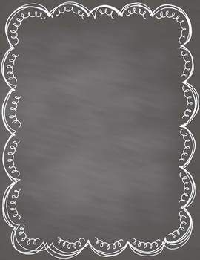
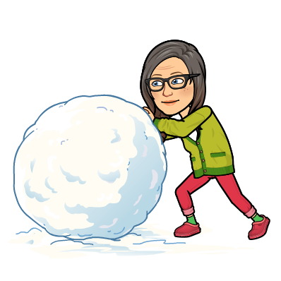
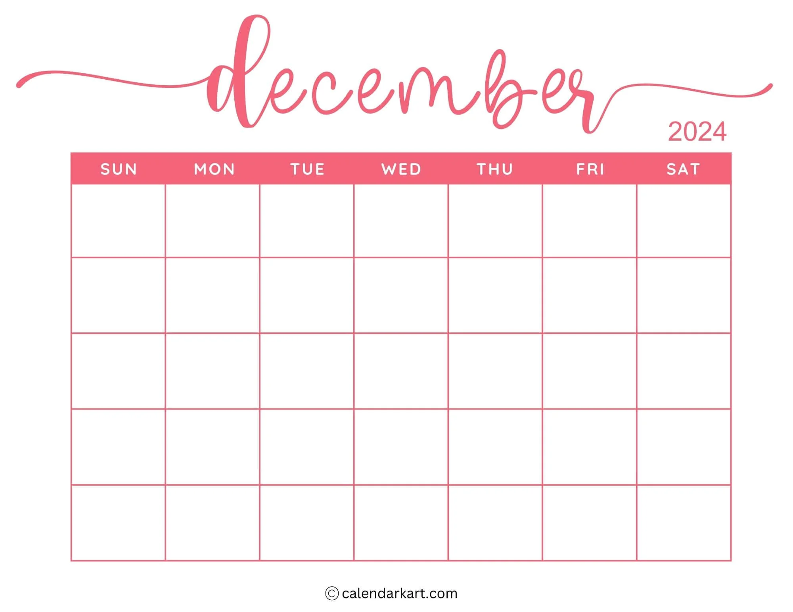
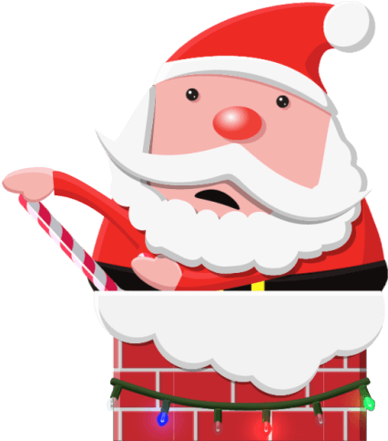
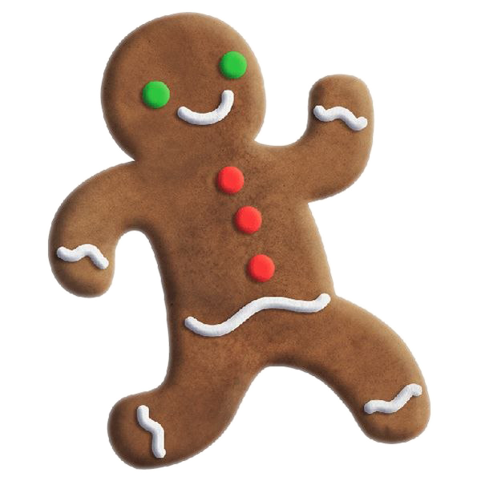
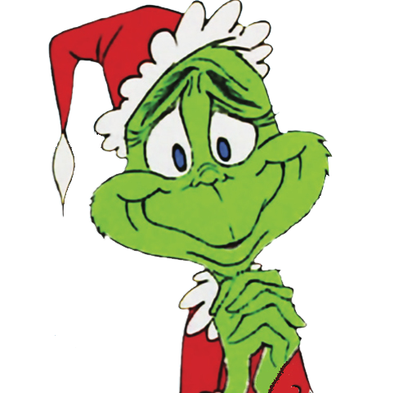
Dates to Remember
in
Dates to Remember in December
I will send the form in Maverick folders on Monday, November 27
(Please return form by Thursday, November 30)
*Holiday Shopping: Dec. 8 11:20-11:50*
*Holiday Party Friday, Dec. 15 10:15-11:45*
Families Welcome!
Dress up Days:
Mid Year
i-Ready
Assessments
Begins
4 Cathedral
Caverns
Field Trip!
1 2 3 5 6 7
Mid Year
DIBELS
Testing
8 9 10 11 14
12 Holiday
Shopping
1:05-1:35
13
Nutcracker
Field Trip!
17
18
Holiday Party
1:00-2:00
19
1/2 Day
for students
20
1/2 Day
for students
15 16 PJ Day & House Day 21
22 23 24 25 26 27 28
Winter Holidays!
29 23 24 25 26 27
12/23-1/6
Cathedral Caverns Field trip December 4
Your child will need to..
1-Make it to school on time
2-Dress for weather and walking at the Caves
3-Bring a DISPOSABLE lunch packed in a labeled ziploc bag, if you did not pre-order a school sack lunch.
Nutcracker Field Trip December 13
Your child will need to..
1-Make it to school on time
2-Dress to impress! (Sunday/Celebration Clothes)
Holiday Shopping December 12
Your child will need to..
1-Bring Money if you would like for them to shop.
2-Complete the list of gifts to buy and how much to spend.
Holiday Party December 18 1:00-2:00
Parents are welcome to join us!
-Wear PJS!
I will share a sign-up genius for the things we will need to have a great celebration!
I hope you will be able to join us!

Slide 3
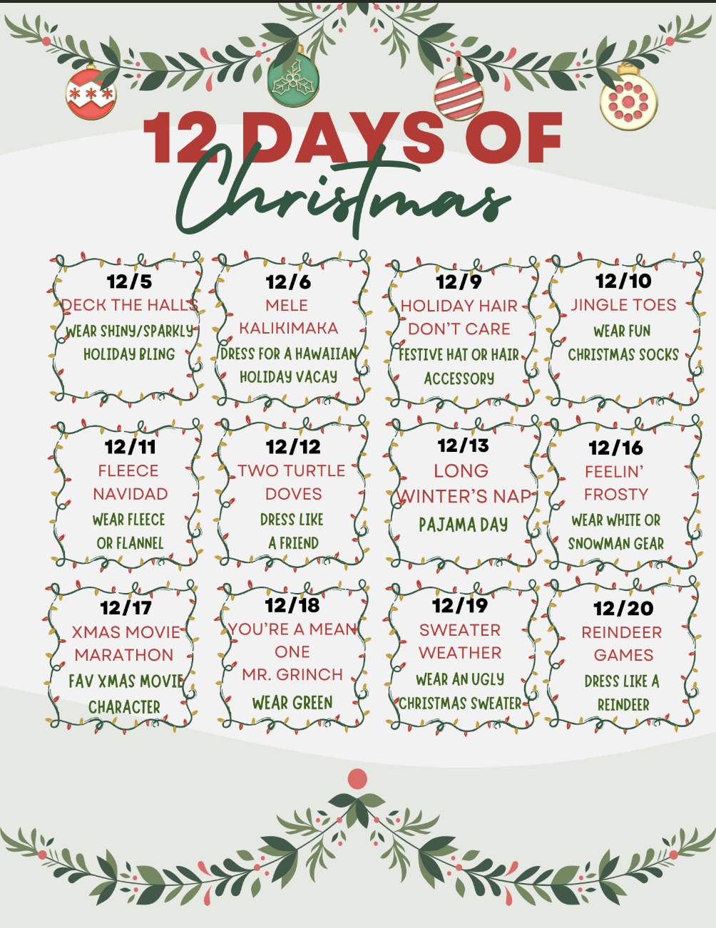
Dates to Remember in December
I will send the form in Maverick folders on Monday, November 27
(Please return form by Thursday, November 30)
*Holiday Shopping: Dec. 8 11:20-11:50*
*Holiday Party Friday, Dec. 15 10:15-11:45*
Families Welcome!
Dress up Days:
at the Mill!
Nutcracker
Dress to Impress!
Wear
PJS!

